Slide 1
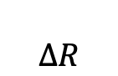

Optoacoustics of
SrRuO₃ flakes
SRO (55 u.c.) // CaF₂
$$ΔR$$
640 nm
$$Δt$$
800 nm

Slide 3
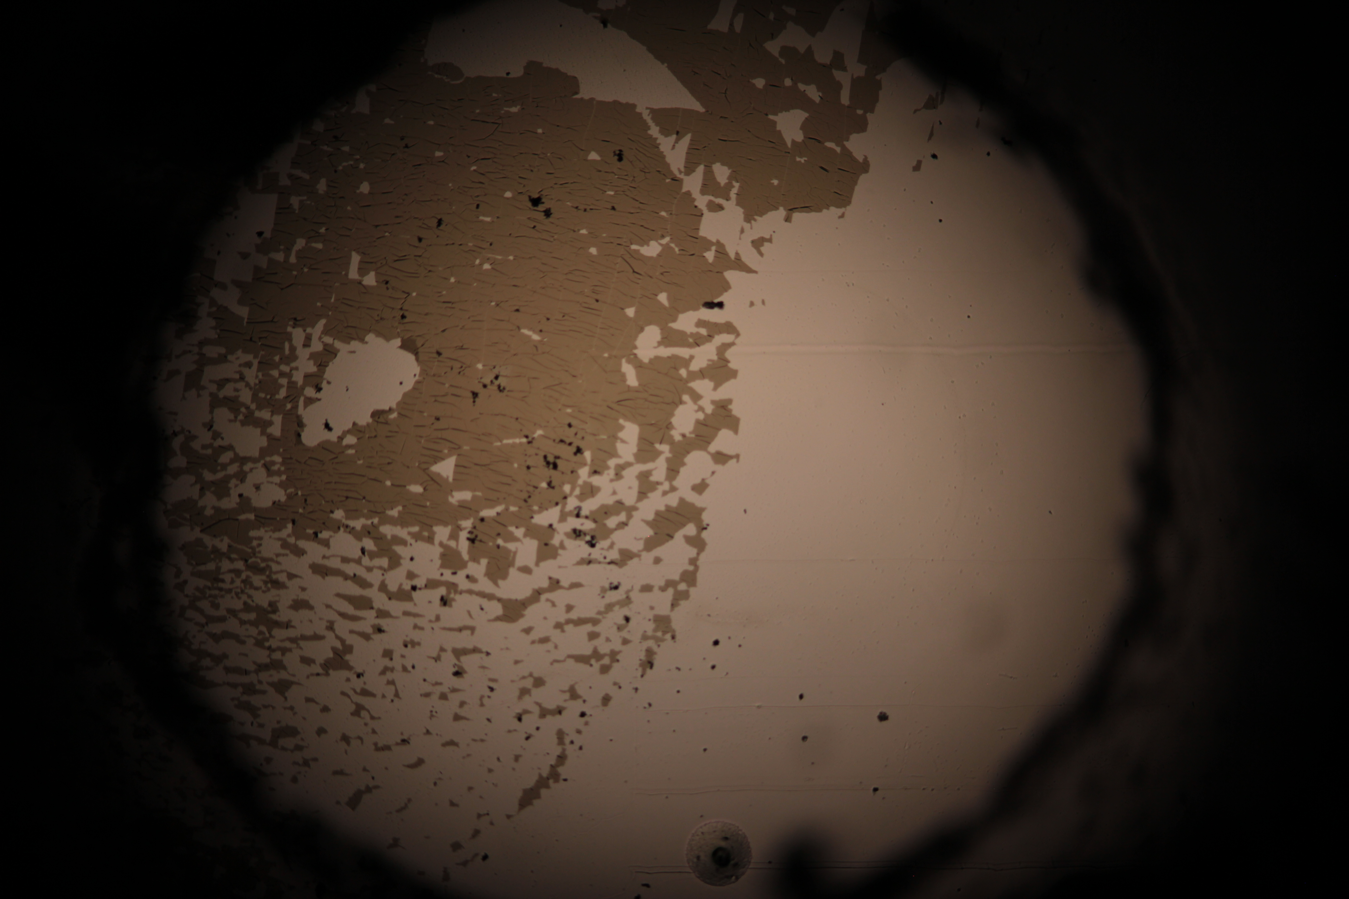

Slide 5
Excitation power dependence

Slide 6
Supported v. epitaxial films
SRO
SRO
CaF₂
STO
Supported film / flake
Epitaxial film

Slide 7
Supported v. epitaxial films
55
SRO
CaF₂
SRO
STO

Slide 8
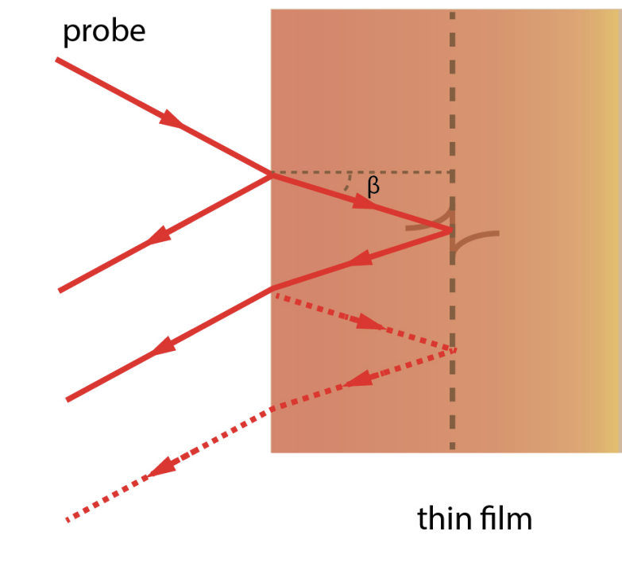

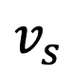
Supported v. epitaxial films
SRO
STO
$$f= \frac{2nv_{s}}{λ_{0}}=42 GHz$$
$$v_{s}$$

Slide 9
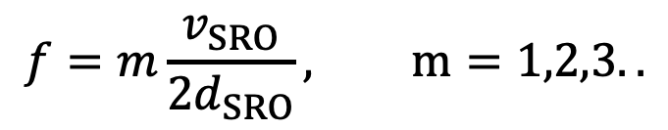
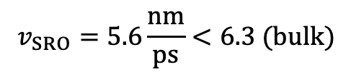
Supported v. epitaxial films
SRO
CaF₂
$$f=m\frac{v_{SRO}}{2d_{SRO}}, m=1,2,3..$$
$$v_{SRO}=5.6\frac{nm}{ps}<6.3 (bulk)$$

Slide 10
Bare substrate
STO

Slide 11
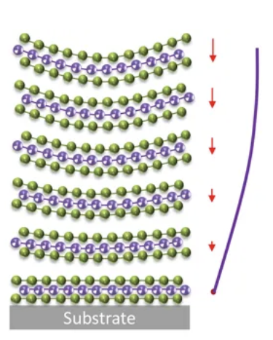
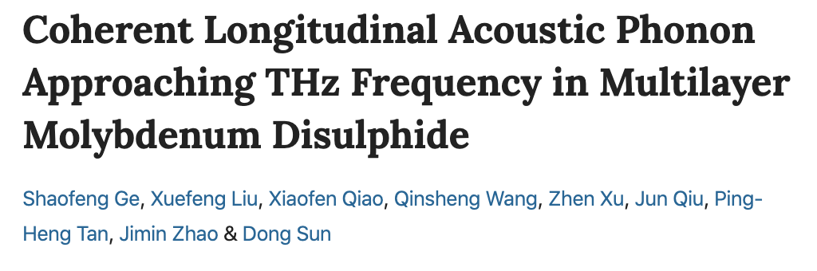
Previous work

Slide 12
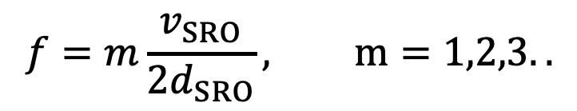


Vibrating string with fixed ends
CaF₂
SRO
$$δ≈d_{SRO}=30 nm$$
$$r=\frac{Z_{CaF2}−Z_{SRO}}{Z_{SRO}+Z_{CaF2}}=−0.22$$
$$f=m\frac{v_{SRO}}{2d_{SRO}}, m=1,2,3..$$

Slide 13
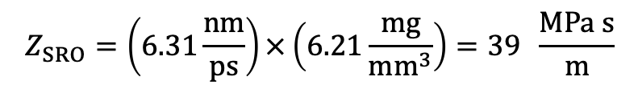
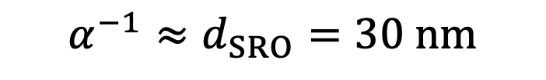
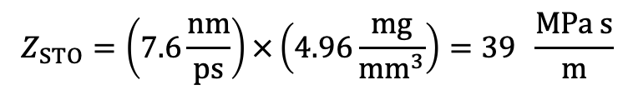
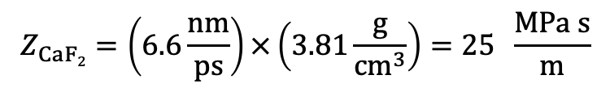
SRO (80 u.c.) // CaF₂
$$α^{−1}≈d_{SRO}=30 nm$$
$$Z_{STO}=\left(7.6\frac{nm}{ps}\right)×\left(4.96\frac{mg}{mm^{3}}\right)=39 \frac{MPa s}{m}$$
$$Z_{SRO}=\left(6.31\frac{nm}{ps}\right)×\left(6.21\frac{mg}{mm^{3}}\right)=39 \frac{MPa s}{m}$$
$$Z_{CaF2}=\left(6.6\frac{nm}{ps}\right)×\left(3.81\frac{g}{cm^{3}}\right)=25 \frac{MPa s}{m}$$

